Slide 1
Novartis Application

Slide 2

Home Page
This screen stays for 2 seconds and moves to next screen

Slide 3





Sign Up Page
Guest needs to fill up all the details I.e. Name, employee ID and email ID
After filling in all the details, the guest needs to press the button ‘Let’s Try’ to start the game
Locate the elements asked for, with your phone camera. Earn points on finding the right elements and win exciting prizes.
Name
Employee ID
Email ID
LET’S TRY

Slide 4
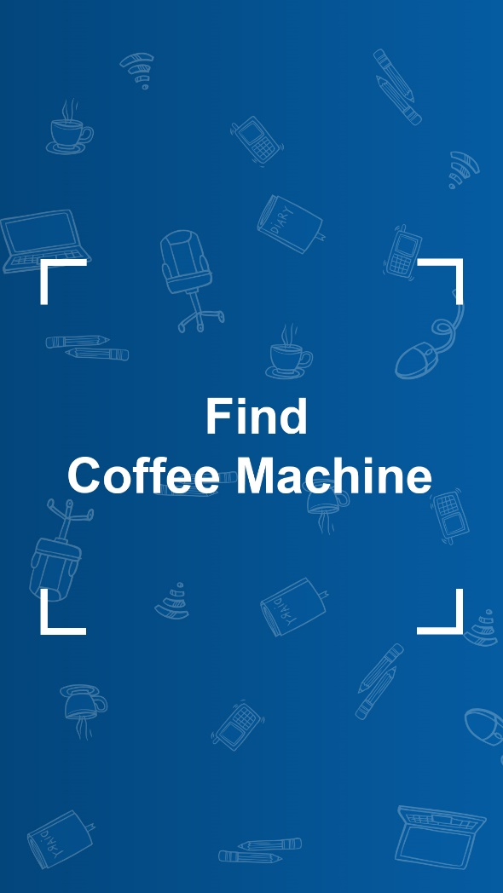
Find object Page
This screen stays for 2 seconds and moves to next screen

Slide 5

Countdown
Stays for 3 seconds
Has a 3 second animation counting down from 3-2-1
Play to see animation

Slide 6



Scanning Surroundings
0
0
The camera window opens.
On the top of the screen:
Number of objects found (starts with 0 and increases as the guest progresses in the game)
Score (a random score is assigned to each object which gets added when the guest finds the object)
Camera Window

Slide 7

Object Found
1
10
When the guest finds the target object, the following things happen
Overlay with the message (each object has a message to go with it)
Number of Objects found increases by 1
Score increases
Guest has to press the button ‘Next to move ahead in the game and go on to the next object.
NEXT

Slide 8
On pressing ‘Next’, the same process is followed for the next 9 objects
0
0
1
10
NEXT
Find Object
Countdown
Scanning Surroundings
Object Found

Slide 9
Finish Page
10
100
Once the guest is done with all 10 objects, s/he gets an option of ‘Finish’ at the bottom of the page.
Guest to press the button to move on to the final screen.
FINISH

Slide 10
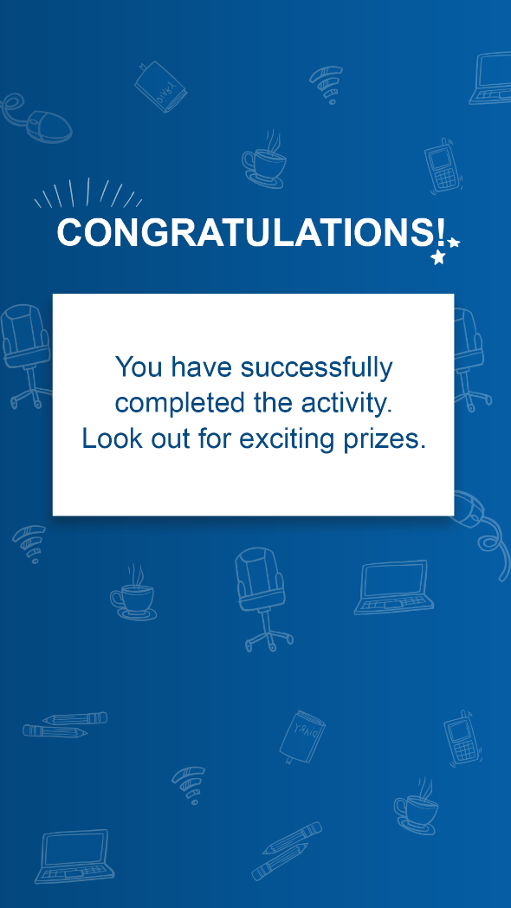
Congratulations Page
On pressing the ‘Finish’ button, the final page Congratulating the guest is visible.
This page stays till the time the guest closes the app.

